Slide 1
Shape based CBIR using Image Segmentation Techniques
Made By-
Shashank Pathak (15BCE1287)
Ayush sharma (15BCE1335)
Shashank Shekhar Shukla (15bce1012)
Made For-
Course code: cse3018
Course name: CONTENT BASED IMAGE AND VIDEO RETRIEVAL
Faculty: DR. GEETHA S.

Slide 2
Abstract
CBIR (Content Based Image Retrieval) is a technique to perform retrieval of images from a large database based on the query image features.
Traditional Image Search Technique use metadata such as tags, keywords to perform a retrieval whereas CBIR model uses the content in the image to retrieve the images. The word content with respect to images means various features of the image like color, texture, histogram.
One such feature set is Shape Based feature which is used to find the shapes of objects in the image and used as a descriptor for shapes of objects. We have used Image Segmentation Methods to segment the images and discriminate various objects present in the image.
We have implemented a CBIR based Model using Shape Based Features as descriptors on the segmented images. We will be using Cell Dataset provided by the Murphy Labs for implementation of this model.

Slide 3
Dataset
This is a cell dataset from murphy labs
It consists of 5 classes and 500 images.
Classes:
Microtubules
Endosome
Nucleus
Golgi gia
Nucleolus
The also provided 50 images containing multiple nucleus to experiment with image segmentation. We have used these two datasets for out PBL.

Slide 4
Segmentation
Segmentation partitions automatically one image into regions.
Segmentation algorithms consider the context, scale, neighbourhood meaning.
Types of Segmentation:
Thresholding (Adaptive and OTSU)
Edge Detection (Sobel , Canny , Laplacian)
Watershed
K means

Slide 5
Thresholding
Thresholding provides an easy and convenient way to perform the segmentation on the basis of the different intensities or colors in the foreground and background regions of an image. It is useful to be able to separate out the regions of the image corresponding to objects in which we are interested, from the regions of the image that correspond to background.

Slide 6
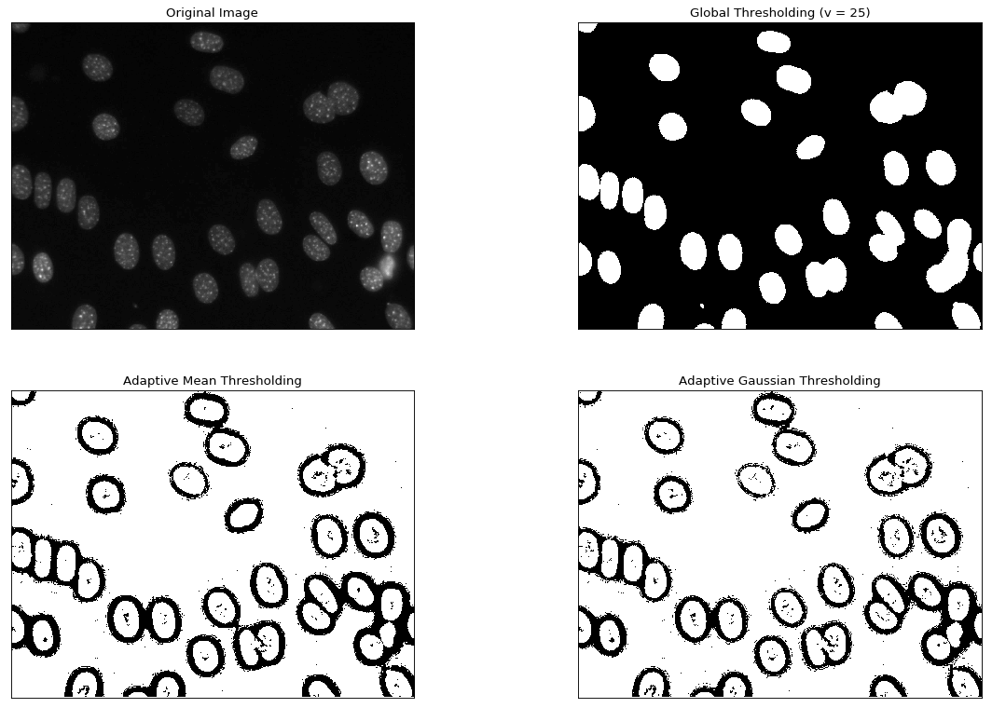
Output of Thresholding (Adaptive)

Slide 7
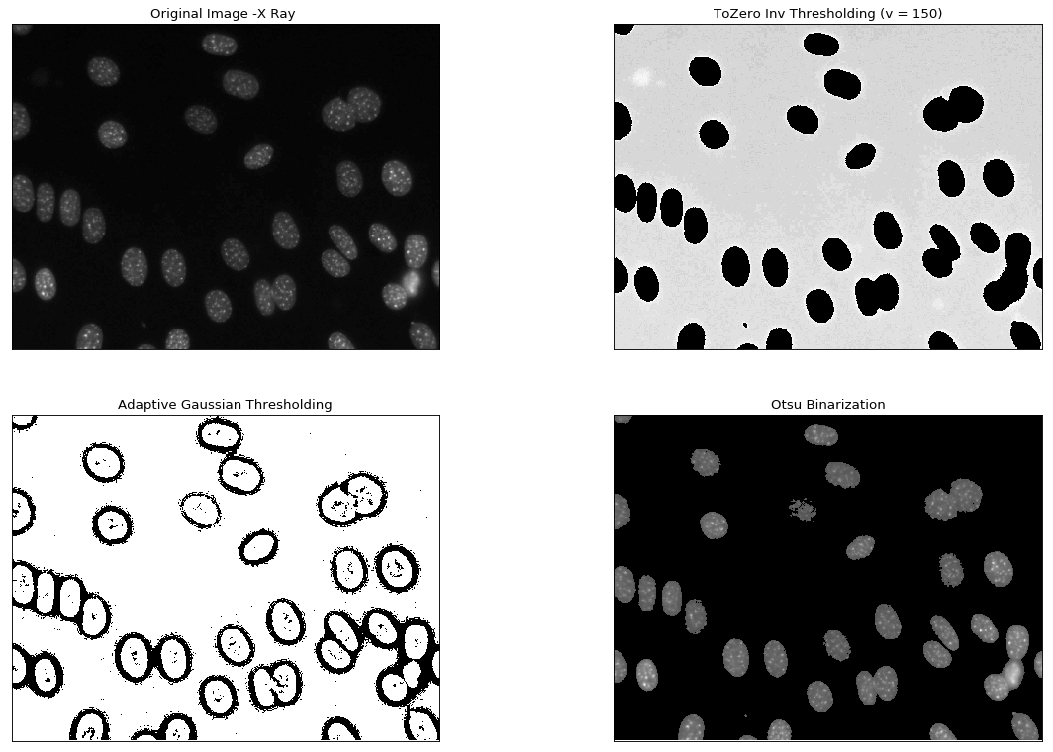
Output of Thresholding (OTSU)

Slide 8
Edge Detection
Edge detection is finding the boundary which separates the two regions. Edge detection detects the edges of the regions and creates a segmentation based on the detected edges. Segmenting the region inside one edge as one segment.
We have used Canny , Sobel and Laplacian edge detection methods to segment our images from the dataset.

Slide 9
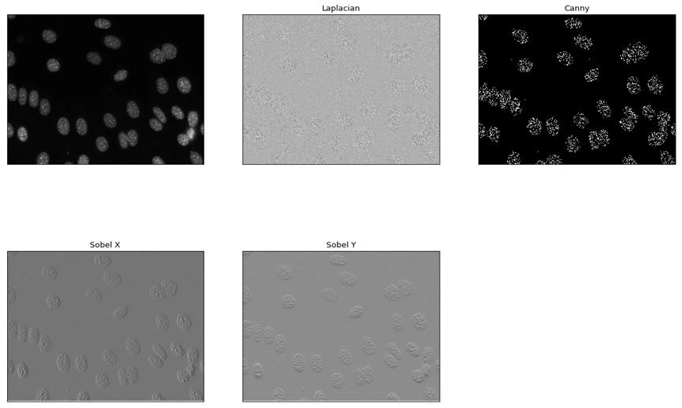
Output

Slide 10
K means
K -means clustering algorithm is an unsupervised algorithm and it is used to segment the interest area from the background. K means uses clustering to segment the image. Using intensities values of the pixel the image is segmented into K color channel crystals. We can specify the K value and the intensities of the image are clustered into K clusters.

Slide 11
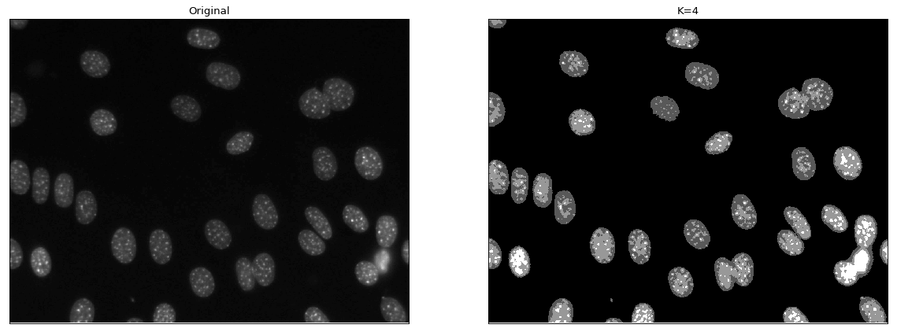
Output

Slide 12
Watershed
Watershed segmentation algorithm finds the “watershed lines” in an image in order to separate the distinct regions. To imagine the pixel values of an image is a 3D topographic chart, where x and y denote the coordinate of plane, and z denotes the pixel value. The algorithm starts to pour water in the topographic chart from the lowest basin to the highest peak.

Slide 13
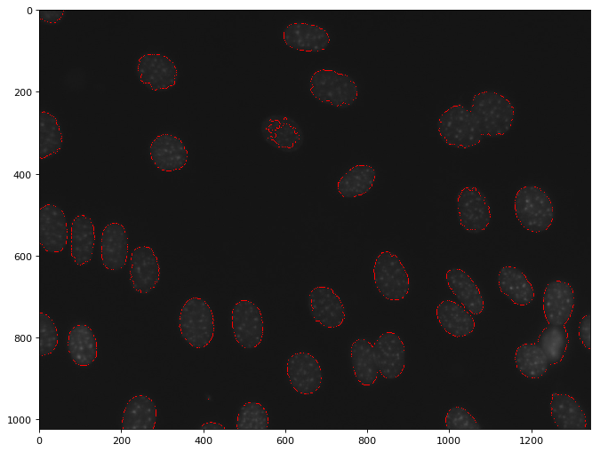
Watershed Output

Slide 14
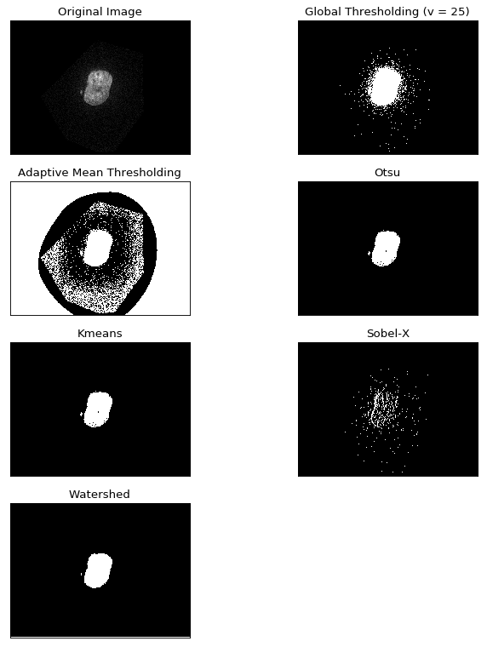
Segmentation summary

Slide 15
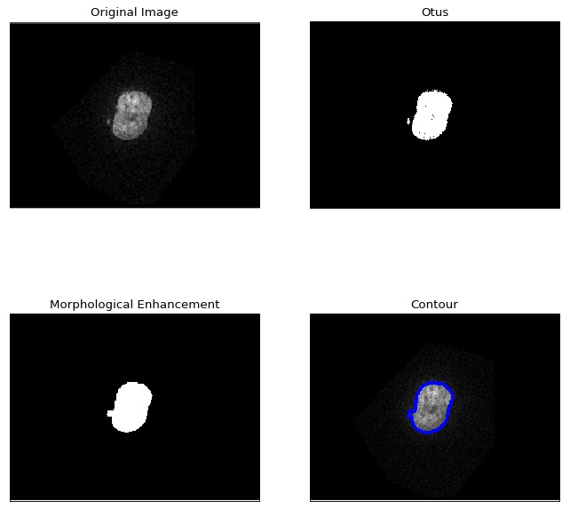
Morphological Enhancement

Slide 16
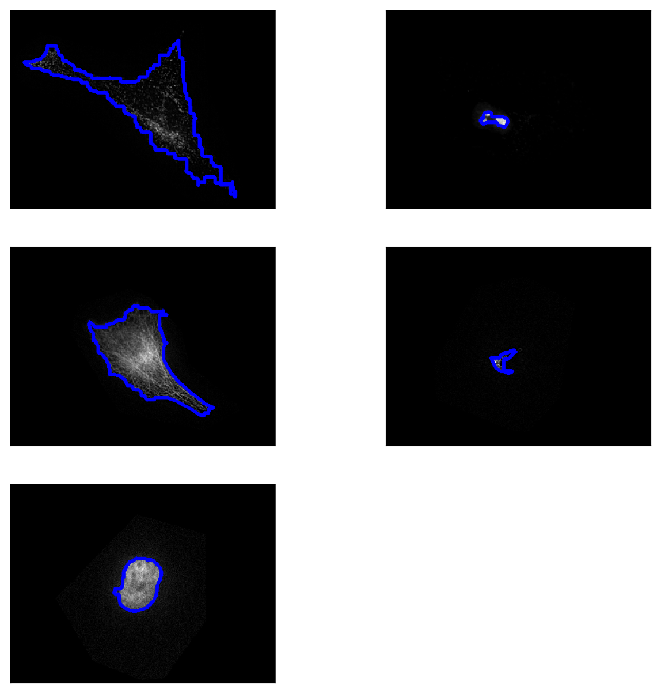
Contour of query images

Slide 17
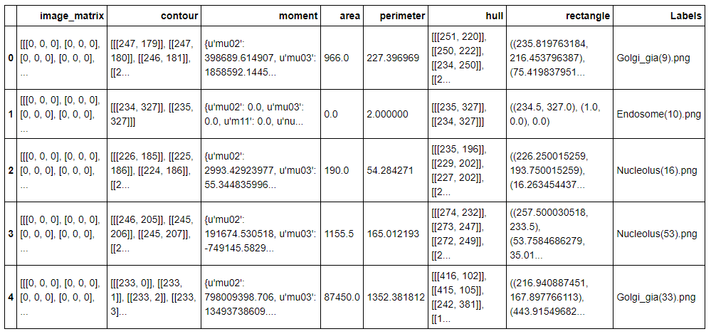
Feature Extraction

Slide 18
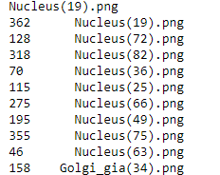
Results

